Slide 1

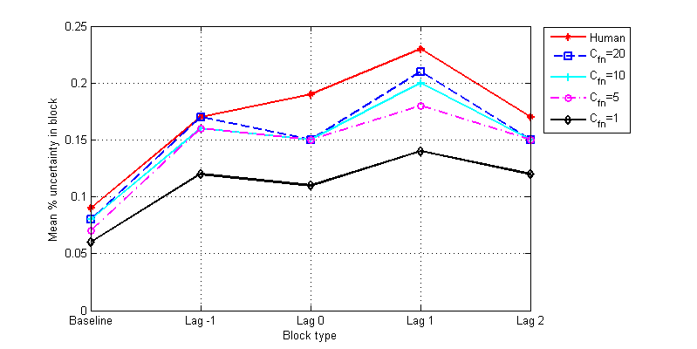
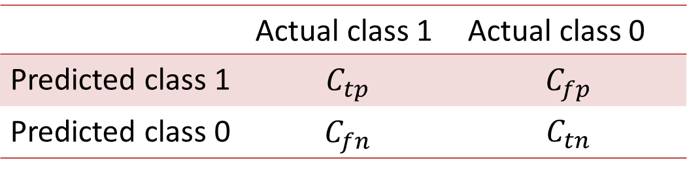
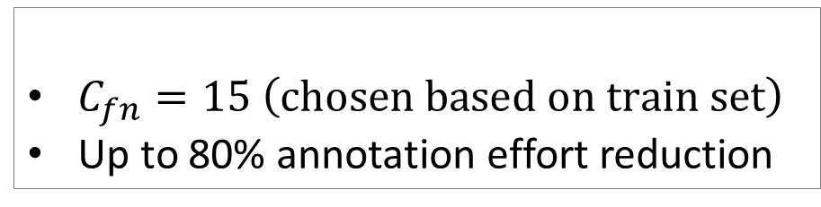
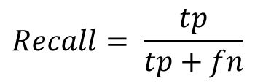
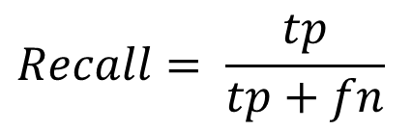
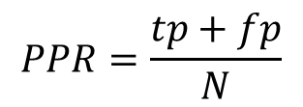

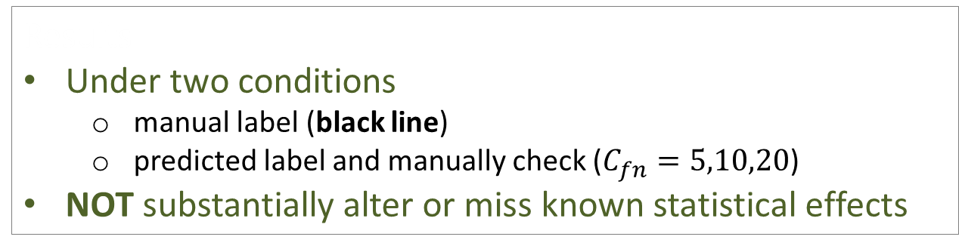

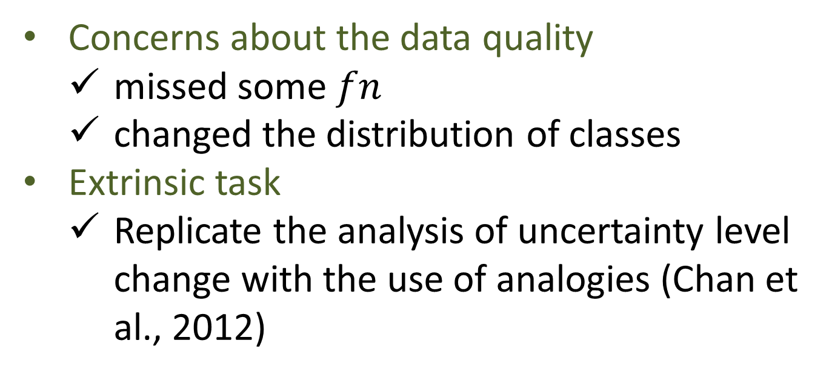
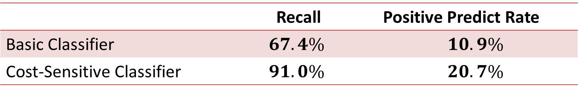
Reducing Annotation Effort on Unbalanced Corpus based on Cost Matrix*
Wencan Luo¹, Diane Litman^{1,2} and Joel Chan²
¹Department of Computer Science, University of Pittsburgh
²Learning Research and Development Center, University of Pittsburgh
{wencan,litman}@cs.pitt.edu, {joc59}@pitt.edu
Motivation
Our Approach
Extrinsic Evaluation
High-quality annotated corpora are desirable.
Annotation is tedious and costly.
It’s a tradeoff between data quality and human effort.
Reducing annotation effort but not hurting the quality?
Belongs to pre-annotation
Annotation Steps:
build a high-recall classifier
apply to the rest of the unlabeled data
manually check every positive label
Concerns about the data quality
missed some $fn$
changed the distribution of classes
Extrinsic task
Replicate the analysis of uncertainty level change with the use of analogies (Chan et al., 2012)
Cost Matrix High-Recall Classifier
Cost-sensitive problem
a trivial solution : classify all instances as ‘1’
100% recall, but high positive predict → no cost savings
Objective: high recall & low positive predict rate (PPR)
Quality
Recall
Effort
PPR
$$PPR=\frac{tp+fp}{N}$$
Results
Under two conditions
manual label (black line)
predicted label and manually check ($C_{fn}=5,10,20$)
NOT substantially alter or miss known statistical effects
Annotation Trade-off
Unbalanced Corpus
 | Actual class 1 | Actual class 0
Predicted class 1 | $$C_{tp}$$ | $$C_{fp}$$
Predicted class 0 | $$C_{fn}$$ | $$C_{tn}$$
$$Recall= \frac{tp}{tp+fn}$$
Reducing effort & NOT hurting quality
Cost-sensitive Classification Problem
High quality
High recall
Low effort
Low PPR
Objective: $max \left(Recall −PPR\right)$
tp: true positive
fp: false positive
N: total number
Intrinsic Evaluation
$$PPR=\frac{tp+fp}{N}$$
$$Recall= \frac{tp}{tp+fn}$$
Transcribed human-human dialogues
Annotated by two coders (kappa = 0.75)
for presence/absence of uncertainty
Skewed Distribution (unbalanced degree: 3% ~ 24%)
text classification (Forman, 2003)
information extraction (Hoffmann et al., 2011)
emotion detection (Ang et al., 2002; Alm et al., 2005)
sentiment classification (Li et al., 2012)
polarity of opinion (Carvalho et al., 2011)
uncertainty and correctness of student answers in tutoring dialogue systems (Forbes-Riley and Litman, 2011; Dzikovska et al., 2012)
Speaker | Utterance | Uncertainty?
S6 | You can't see the forest through the trees. | No
S1 | I'm not quite sure | Yes
Conclusion
 | # of Utterances | Unbalanced Degree
Train | 12,331 | 13.3%
Test | 1,558 | 14.2%
Unlabeled | 42,641 | ?
An annotation scheme based on cost matrix
lowers the threshold to build a high-recall classifier
reduces significant annotation effort (by checking only the positive predictions)
does not sacrifice data quality
Future work
experiment with different tasks
extend to multi-class classification tasks
explore effects of the degree of unbalance
Related Work
Semi-supervised learning methods
active learning (Cohn et al., 1994; Zhu and Hovy, 2007; Zhu et al., 2010)
co-training (Blum and Mitchell, 1998)
self-training (Mihalcea, 2004)
Supervised methods + manual checking
pre-annotation (Brants and Plaehn, 2000; Chiou et al., 2001; Xue et al., 2002; Ganchev et al., 2007; Chou et al., 2006; Rehbein et al., 2012)
Basic Classifier
Feature Set
133 Keywords/Phases
High Recall Classifier
$C_{fn}=15 \left(chosen based on train set\right)$
Up to 80% annotation effort reduction
 | Recall | Positive Predict Rate
Basic Classifier | $$67.4\%$$ | $$10.9\%$$
Cost-Sensitive Classifier | $$91.0\%$$ | $$20.7\%$$
* This work is published in NAACL-SRW, 2013
Wencan Luo, Diane Litman and Joel Chan. Reducing Annotation Effort on Unbalanced Corpus based on Cost Matrix. Proceedings of the NAACL HLT Student Research Workshop, Atlanta, GA, June.

